Slide 1

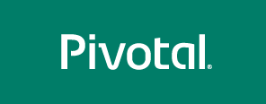
PCF Advanced Dev
Extreme Cloud Native Platform

Slide 2
Agenda
Pivotal / Cloud Foundry Introduction
Cloud Native
PCF Architecture
Code Demos!
Notes:
Today’s workshop will take you through the list here – it will not be focused on “convincing” you to use Pivotal Cloud Foundry, but make you aware of how to use it to accomplish your goals.
Sprinkled throughout will be customer successes as related to the content/features we are discussing at that moment.
Think, entertaining superbowl commercials –
GE, Comcast, Cardinal Health, a Power Grid Customer

Slide 3
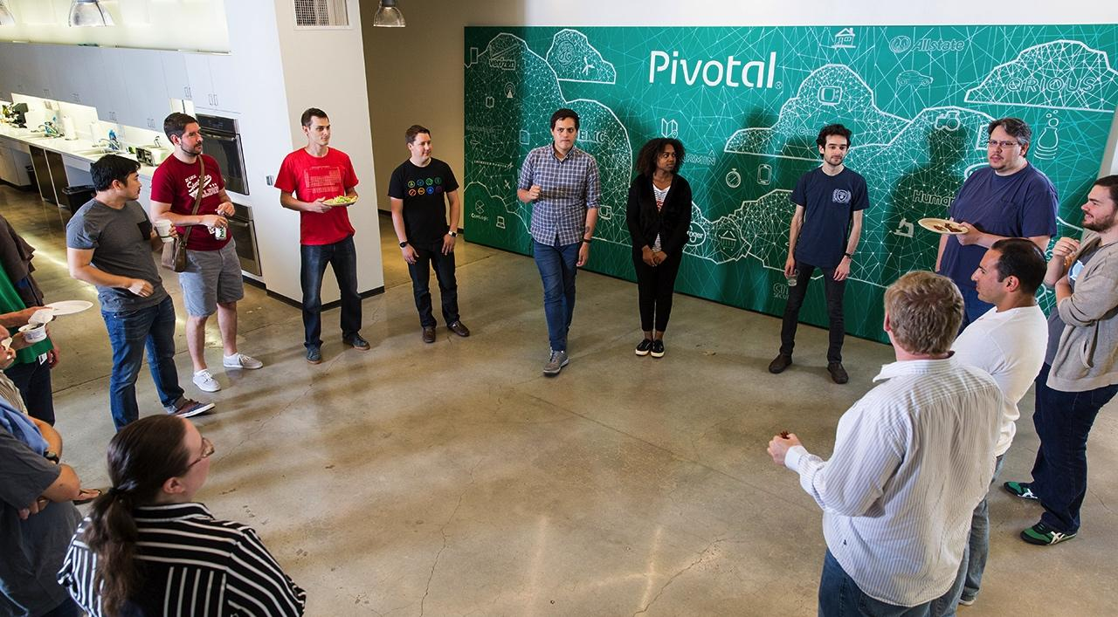

Our mission is to transform how the world builds software

Slide 4
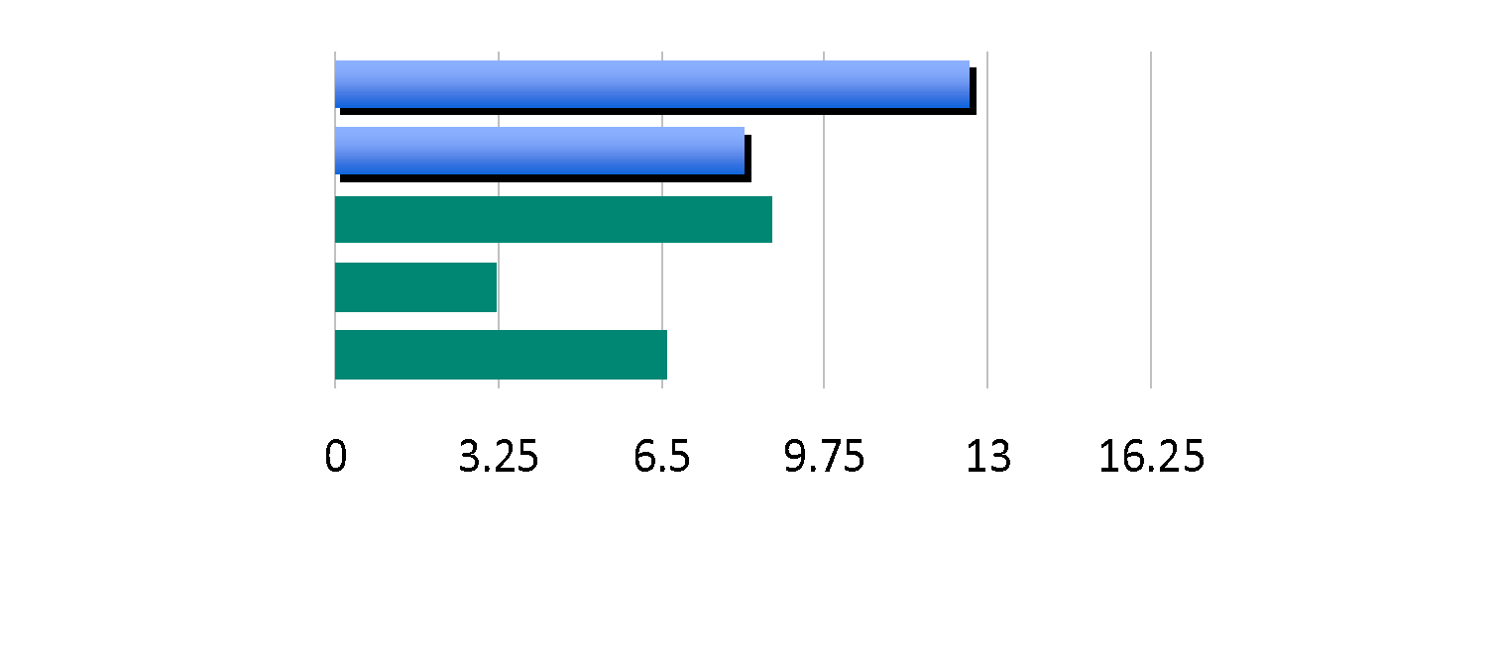
Software developers spend too much time NOT writing software
Design and Coding
Brainstorming
Administrative tasks
Managing Environments
Waiting for Test/Build
Average Hours/Week
Sources: “Electric Cloud LinkedIn Survey to software developers”

Slide 5
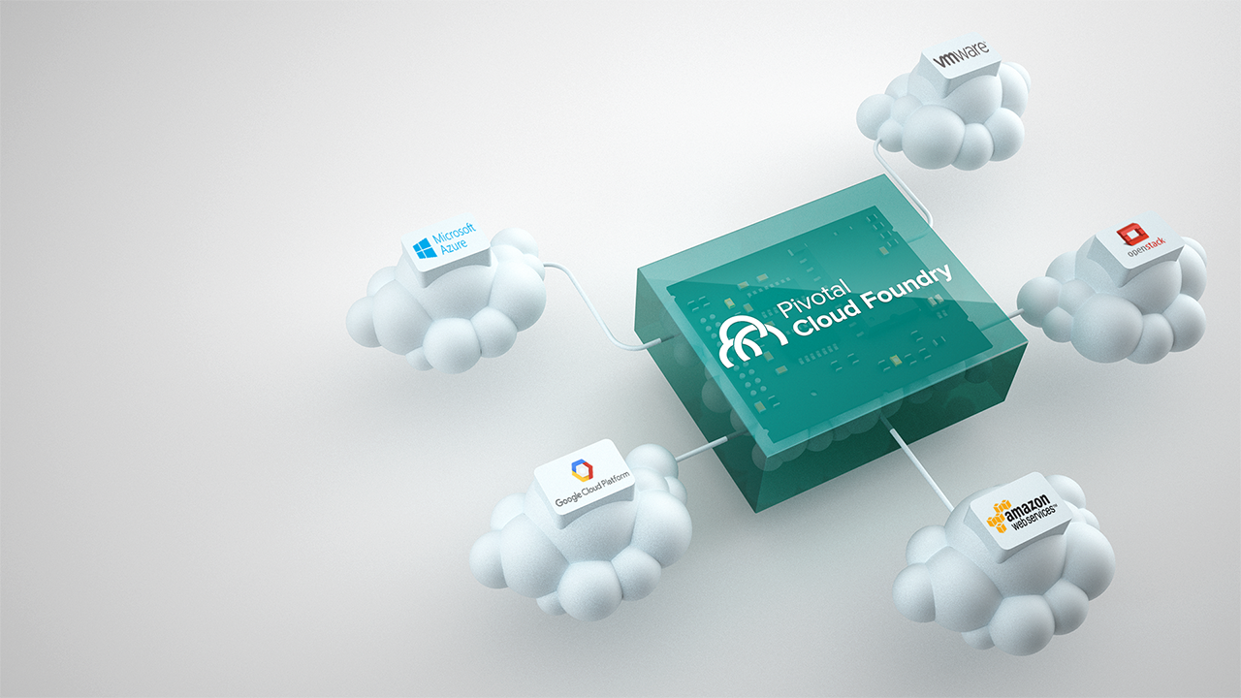
01
Modern Cloud-Native Platform
Building high-quality software at start-up speed requires modern software methodologies, cloud platform, and data tools

Slide 6
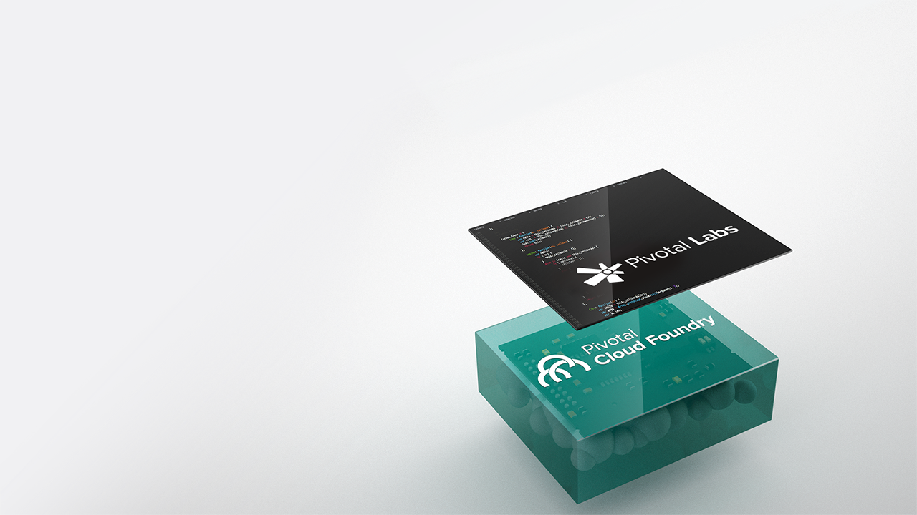
02
Modern Software Methodologies
Ensuring teams are supported by modern methodologies and technical knowledge to continuously innovate
Guidance & Coaching
Software Engineering
Product Management & Design
Data Science

Slide 7
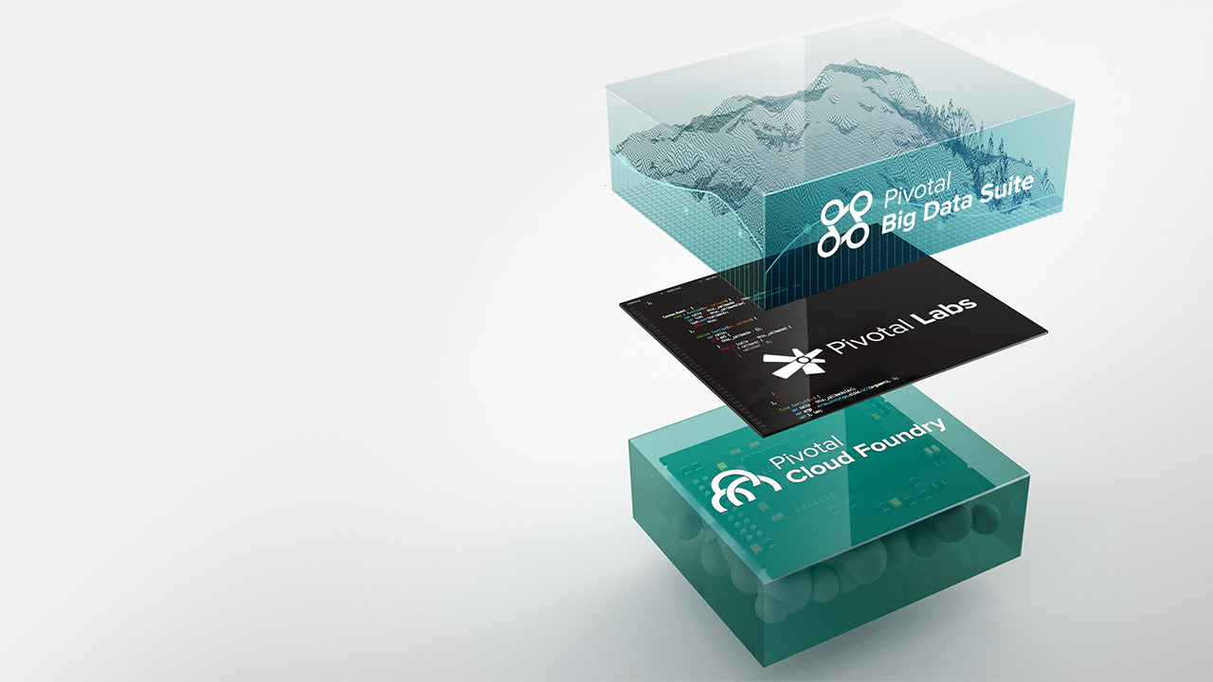
03
Modern Cloud-Native Enterprise
Building high-quality software at start-up speed requires modern software methodologies, cloud platform, and data tools

Slide 8
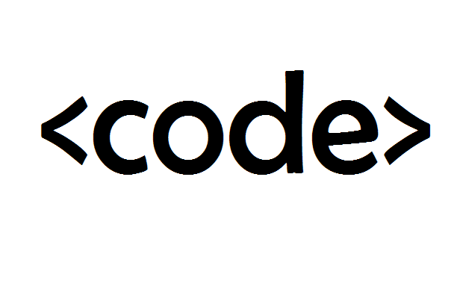
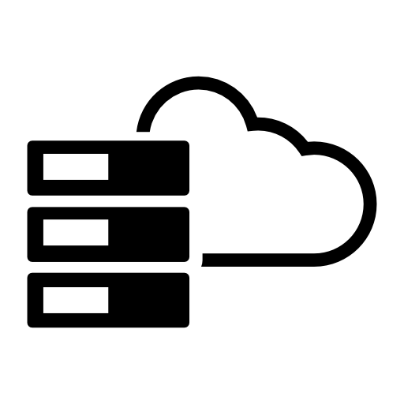
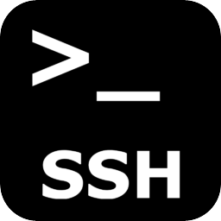
CLOUD FOUNDRY PRINCIPLES
Developer Productivity
Operational Efficiency
Enhanced Security Posture
Notes:
Discuss how PCF addresses Developer Productivity, Operational Efficiency, Enhanced Security Posture. Examples:
Developer: Self-service platform, service provisioning/binding
Operational Efficiency: Automated platform, self-healing, troubleshooting efficiency, integrated monitoring & logging.
Enhanced Security Posture: Rapidly respond to vulnerabilities, zero-down deployments, hardened stemcells
------------------------------
Code Icon: http://3.bp.blogspot.com/-Is-IOWjqp6Q/VW_OvQWMuNI/AAAAAAAABAM/LdKc8p2f6tA/s1600/code.PNG
Sysadmin Icon: http://authors.juni.com/wp-content/uploads/2014/03/data29.png
Security Icon: http://www.pc-freak.net/images/ssh-how-to-login-with-password-provided-from-command-line-use-sshpass-to-run-same-command-to-forest-of-Linux-servers.png

Slide 9
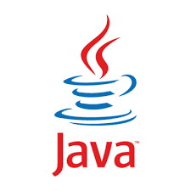
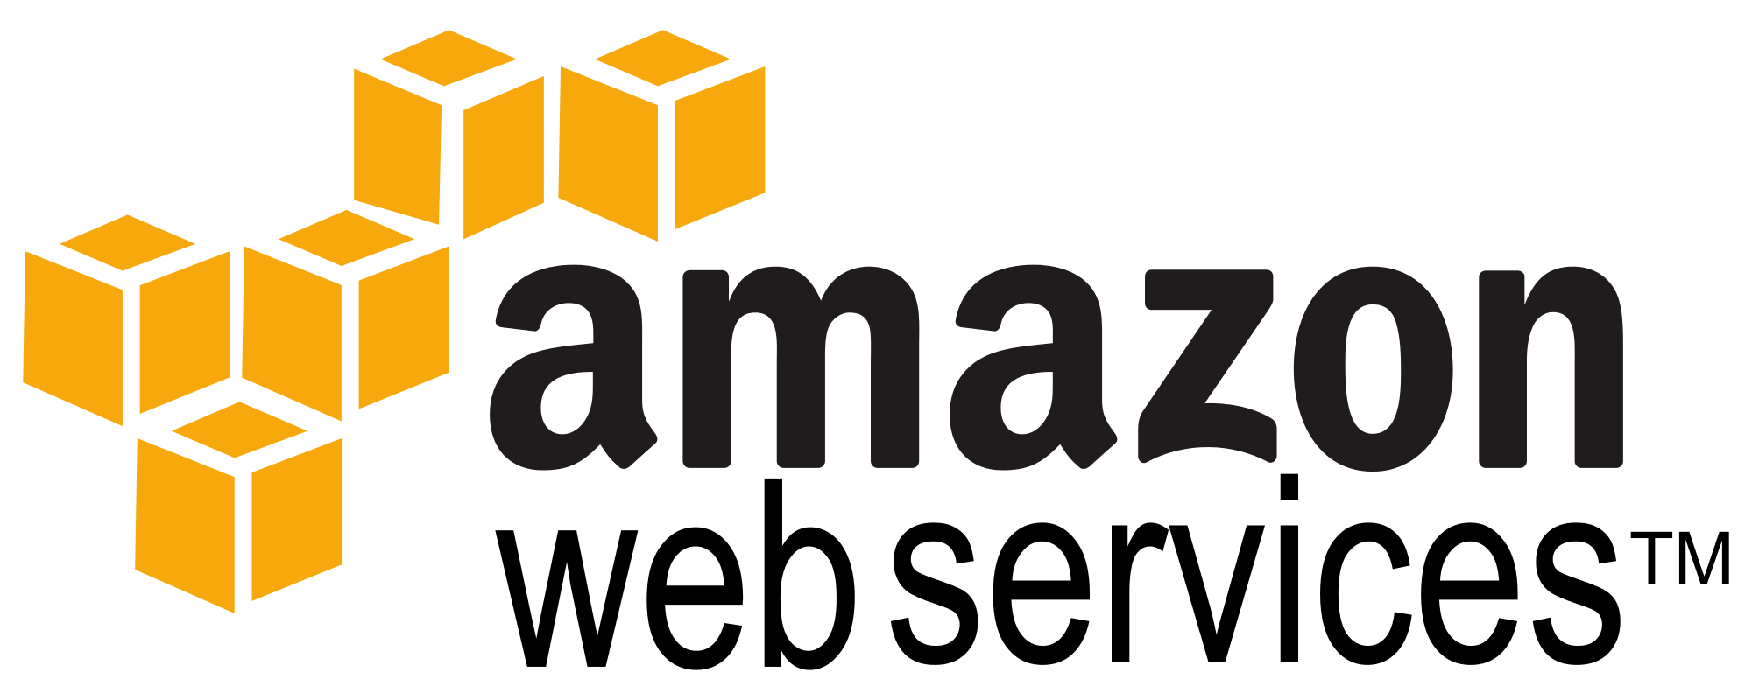
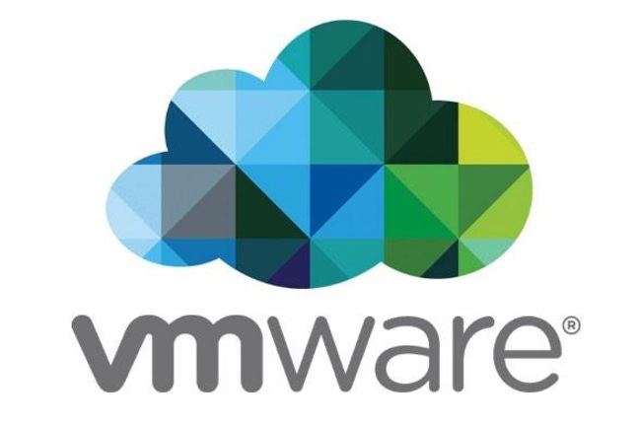


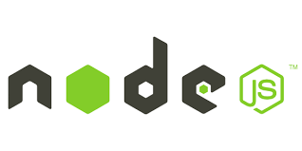
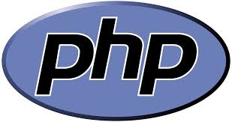
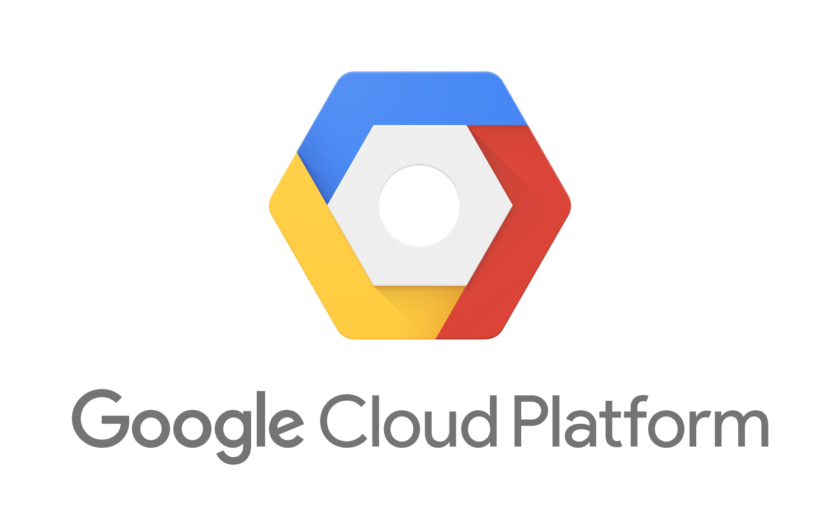


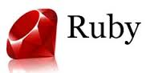
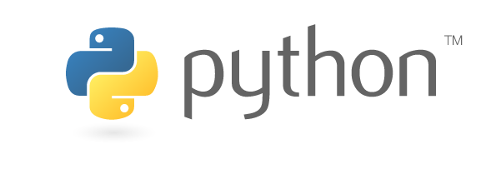
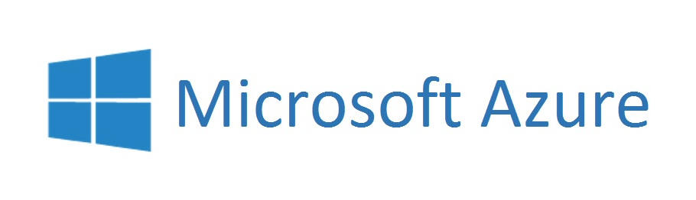

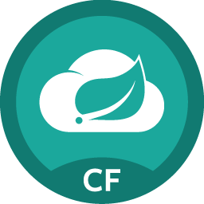
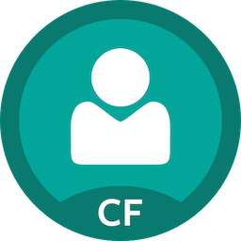
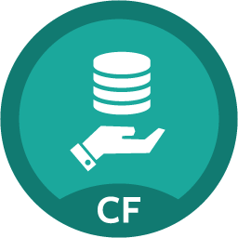

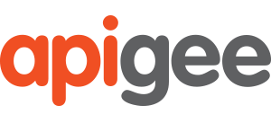
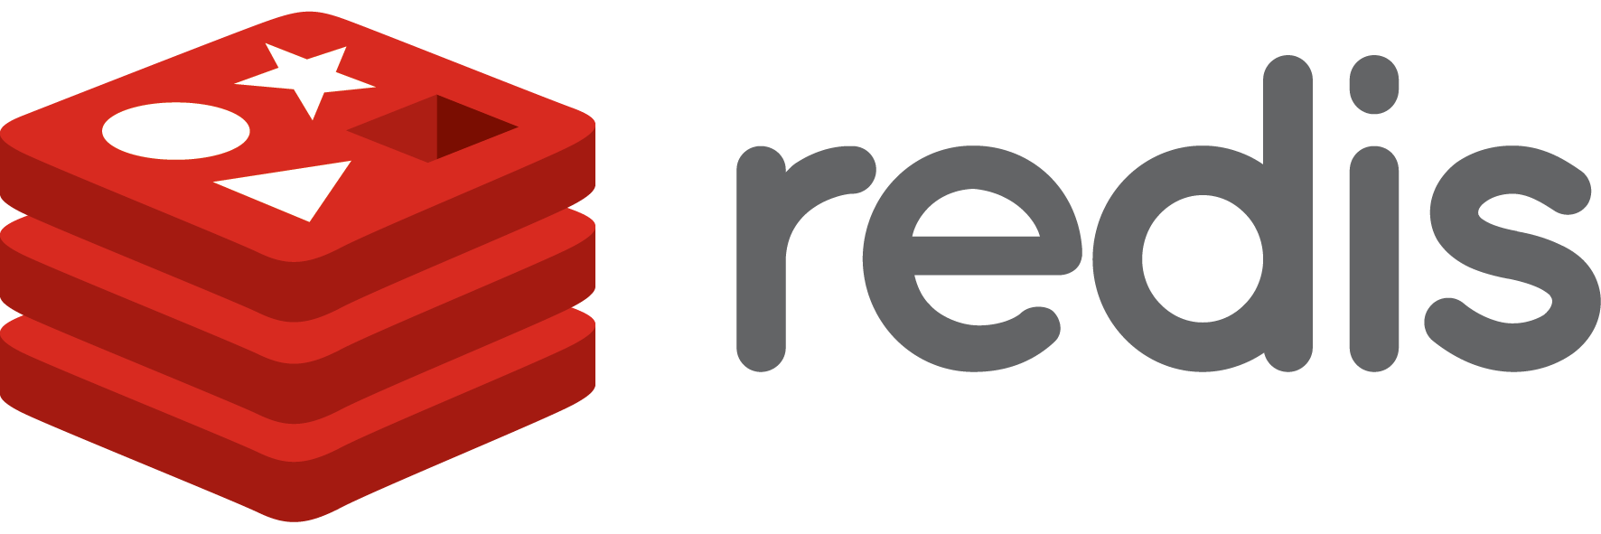

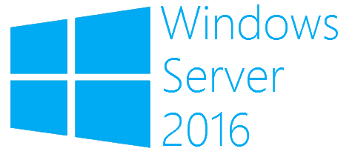
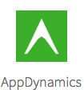
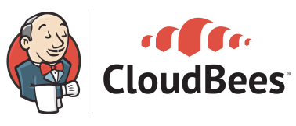
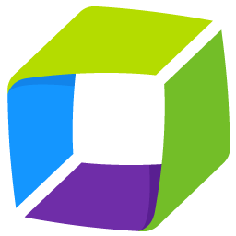
How Pivotal Can Help
Developer Choice
Developer Support
Languages
Clouds
Pivotal Tracker
Metrics, AppDynamics, Dynatrace, New Relic
Language Frameworks & Application Services
Project
Management
Optimize
Code
Apps Manager, CLI, REST APIs, Ops Manager
Language Buildpacks for Staging & Packaging
Manage
Build
Platform Services
OSes
Spring Cloud
Services
Single Sign On
MySQL
Deploy
Provision
Test
API Driven Platform, Concourse, Jenkins
Self-Service and Role-Based Access Control
Dynatrace
AppMon
Container SSH, Loggregator, Metrics
Notes:
HOW PIVOTAL CAN HELP
Before we look specifically at building code, it’s helpful to get a big picture view of all that Pivotal has to offer that can help you be effective in quickly building and delivering applications.
Developer Choice
Pivotal Cloud Foundry provides developers extreme choice in technologies that they choose to leverage in building their applications.
Languages: PCF offers build/deploy automation for many languages including, Java, .Net, PHP, Ruby, Python, node.js and Go. In addition, it is extensible, and can support automated build/package/deploy for other languages, runtimes and frameworks via buildpacks.
Clouds: PCF allows flexibility to run your applications on any cloud infrastructure, whether on-premise (vSphere, Openstack) or with major public cloud vendors (AWS, Azure, Google Cloud Platform). PCF also provides the extensibility to support new and future underlying infrastructures through the Cloud Provider Interface, an infrastructure API layer implemented by the cloud infrastructure provider.
Platform Services: Pivotal has a large and growing collection of developer services that developers can use to build applications rapidly. Services are available from Pivotal as well as its ISV partners. In addition, Pivotal also provides a means to access the large services ecosystems of the major public cloud providers. Finally, Pivotal services ecosystem continues to grow and provide a consistent developer experience thanks to the standardized Cloud Foundry Service Broker abstraction.
OS: Many enterprises currently support mixed linux/windows based workloads. Pivotal Cloud Foundry allows enterprises to run both types of workloads natively on its elastic runtime.
Developer Support
In addition to provide tremendous developer flexibility and choice around key technologies, Pivotal also automates and supports the full spectrum of activities during a software lifecycle.
Project Management: Pivotal provides Pivotal Tracker, the popular agile project management tool, with built in analytics for delivery planning and prediction, and story linking, user feedback and 3rd party integrations, (github, slack, zendesk) to maximize productivity and drive a virtuous feedback loop.
Coding – Pivotal provides the leading application framework (Spring) for Java developers along with .Net/Java access to Spring Cloud Services as well as other highly available developer services for rapid and high quality code development.
Build – Buildpacks provide automation for build, stage, package and deploy workflows in enterprise contexts, that enable not just deployment speed but also deployment consistency and a simplified user experience.
Provision – PCF’s built in quota allocation and provisioning framework allows for efficient self-service access that enables developers to become productive in minutes rather than months when trying to get access to configured compute capacity.
Test – PCF incorporates various tools for debugging and monitoring that can accelerate development by facilitating rapid build-test. Some capabilities that support this include aggregated logs (loggregator). Container SSH to connect securely to a running container, Metrics to monitor application behavior to known test inputs, etc.
Deploy – PCF provides Concourse, a built in CI/CD tool as well as support for Jenkins. Being an API driven platform, these tools can easily use the APIs to orchestrate a CD pipeline to automate testing and deployment.
Manage – PCF provides various means of managing both the platform as well as users and running applications. The platform can be managed by directly calling APIs, or using the CLI or Apps Manager UI (which uses the API) to scale applications, inspect runtime environment configurations and status, etc. In addition, the platform provides Ops Manager to manage the the infrastructure and PCF deployment (using Bosh under the covers).
Optimize – PCF enables metrics gathering and monitoring to enable developers to analyze application behavior in order to fix problems or enhance performance.
Security

Slide 10
Cloud Native Transformation

Slide 11
CI/CD Pipeline
to
Platform

Slide 12

Enabling Continuous Delivery
Development
Operations
Idea
Business
Customer
$
Value
QA
Companies that disrupt, reduce time to value

Slide 13

Enabling Agile Delivery
Behavior Analytics
Design
Development
Customer Feedback
Test
Customer Delivery

Slide 14

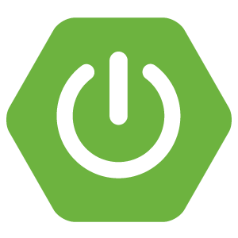


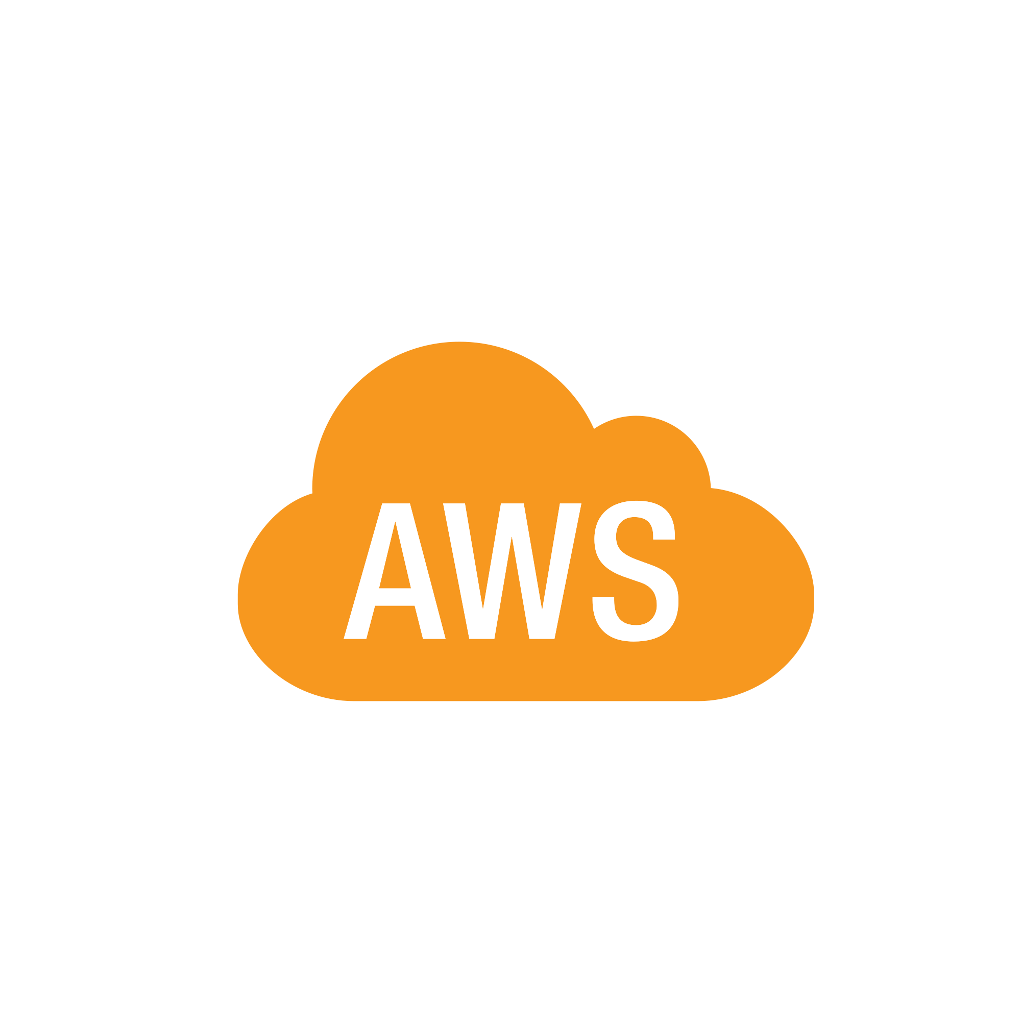
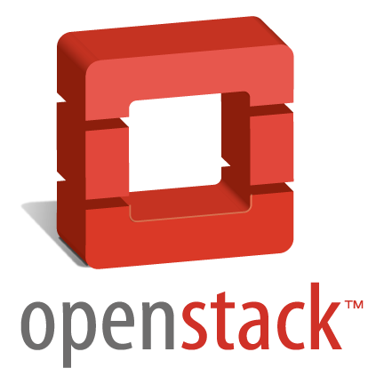
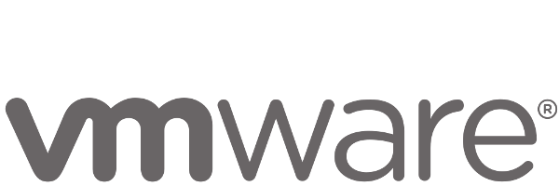
Anatomy of a Cloud Native Platform
1. Application Framework
Developer
Contract – 12 Factor App
2. Container Runtime
Dev+Ops
Contract – BOSH Release
IT Ops
3. Infrastructure Automation
Contract – Cloud Provider Interface
4. Infrastructure
IT Ops
“Contracts” between Applications, opinionated frameworks like Spring Boot and Spring Cloud and opinionated Cloud Native Platforms like Cloud Foundry help significantly accelerate the development of Cloud Native applications
Notes:
That is and should be a governing principle behind any cloud platform, library, or tool. Spring Cloud–an open-source library–makes it easy to develop JVM applications for the cloud. With it, applications can connect to services and discover information about the cloud environment easily in multiple clouds such as Cloud Foundry and Heroku. Further, you can extend it to other cloud platforms and new services.
Application Framework
Spring Cloud : used by Netflix
Spring Boot now over 1M downloads a month, historic levels of growth
Runtime platform
Cloud Foundry elastic runtime used by top FS leaders
Enterprise production ready Linux Container based platform
Infrastructure Automation
CF BOSH: Embedded OS, cloud API integrated
Incredible operational leverage; machine to machine automation

Slide 15
Whiteboard:
PCF Developer Experience

Slide 16






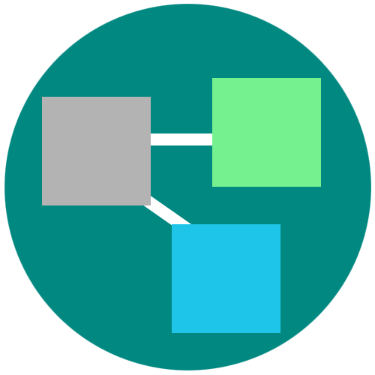
Platform Runtime – Application Centric
Roles and Policy
Log aggregation
Security and Isolation
APM
Scaling
APPLICATION
Blue green deployment
Health management
Notes:
Its no longer about running an app on a single VM and relying on Vm centric scaling to manage demand.
PCF provides an abstraction layer that allow you to scale out with application containers as the unit (not the VMs). So…You will no longer need to know which VM or where your app container is running because PCF surfaces visibility at the app layer and not though infrastructure constructs like VMs. We call this an application “dial tone”
This along with a high degree of automation with no additional wiring needed is what radically simplify application operations
You can do really rapid blue-green deployment, A/B testing, health management needed for the resiliency and fast updates of your apps. It has built in features that wrap full lifecycle management like APM, log aggregation. Policy enforcement and role based access to resources are all integrated and can be set.
Everything that you need for an enterprise grade distributed app container management system is right there.

Slide 17
PCF
Architecture

Slide 18
Elastic Runtime Architecture
Turnkey, Fully automated Cloud Native Platform
Scalable runtime environment, extensible to modern framework and languages
Instant scalable with updates and upgrades with no downtime
Deploy, scale and manage applications with services
Pivotal CF Elastic Runtime
Dynamic Router
ROUTING
OAuth 2.0 Server (UAA)
Login Server
AUTHENTICATION
Cloud Controller
etcd
Auctioneer
APP LIFECYCLE
Brain / BBS
MESSAGING
Service Brokers
CELL
Blob Store
APP STORAGE
& EXECUTION
Garden
Build Packs
Sys Log
Collector
App Log
METRICS & LOGGING
Pivotal CF Ops Manager / BOSH
Notes:
TDB: Sort out the box component to be represented at a high-level. For example, should we brake down the Diego Brain and Cell?
[Cornelia Notes] This should be used as a transition to say “the elastic runtime deployed a cluster of VMs – each of the green boxes is one, usually deployed in duplicates – and BOSH/Pivotal CF OpsManager is what we will talk about now…
*** Original bullets points ***
Turnkey, fully automated Platform-as-a-Service
Scalable runtime environment, extensible to most modern frameworks and languages running on Linux
Instant expansion or upgrade with no downtime
Deploy, scale and manage applications with bindable services using simplified semantics and APIs

Slide 19
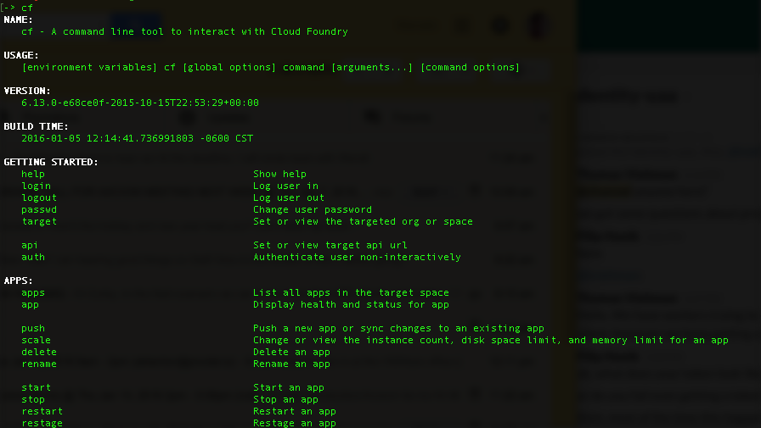
CLI – Command Line Interface
Command line utility providing easy access to the Pivotal CF commands.
Scriptable
Fully documented (cf –help)
Notes:
http://docs.pivotal.io/pivotalcf/console/index.html

Slide 20


D E M O

Slide 21

Deploying an Application
Blobstore
Service
credentials
Upload app bits and metadata
DB
push app
+ app MD
Cloud Controller
Service Broker Node(s)
Create and bind services
Router
Stage application
Container Management - DIEGO
Deploy application
Cell
DEA
Brain
DEA
Manage application health
DEA
+
=
Notes:
We keep the cf push workflow simple and don’t get into the details of DIEGO. We only keep the BRAIN and Cell.
Cloud Foundry PaaS – Pushing an Application with Diego
App deployment: what has changed?
1- Domain specific (notion of apps) -> Abstractions (notions of LRPs and Tasks). App staging is a Task. App start is launching a LRP.
2- Platform specific (linux) -> Supporting multi platform (Windows & Linux) enabling running also .NET apps, thanks to our new Container implementation: Garden
What’s more, there is a 3rd workflow supported: Docker on Linux
3- New Auction-based workload scheduler: Cloud Controller no longer in charge of deciding where AIs are spun up. Auctioneer manages the process running an auction, making it more optimized.
With Diego in place, more loosely-coupled components take part in the process, stripping down the Cloud Controller from too many previous responsibilities, making it easier to maintain and evolve the entire architecture.
The Cloud Controller handles the routing of client requests internally through the Cloud Controller Bridge. It also manages the Blobstore to store packages and droplets and the DB to store App Metadata and Service credentials. Blobstore could be internal or external, depending on the setup.
A service gateway provides an interface for services (native or external).
More in the next slide about the Cloud Controller Bridge (CC-Bridge), the Bulletin Board System (BBS) and the Auctioneer in the next slide
Apps run in a CELL, part of the new Cloud Foundry Runtime, called Diego
Routers manage application traffic.
Diego handles all health management for apps (now LRPs), through a series of single-purpose components: Nsync (part of the CC-Bridge), BBS (part of Diego DB) and the Converger (part of the Diego Brain)
Apps are accessed directly through the router while web and CLI clients (e.g., vmc, STS) access Cloud Controller via RESTful services.

Slide 22
PCF
App Manager

Slide 23
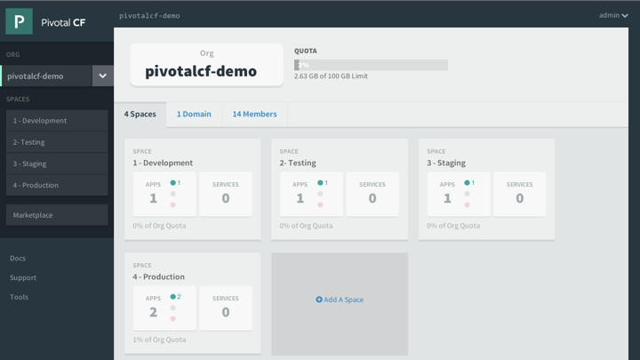
Platform Runtime - Apps Manager
Manage Organizations, users, applications and Spaces
Monitor applications logs, services and routes
Access Service Marketplace, create services and bind to applications
Notes:
http://docs.pivotal.io/pivotalcf/console/index.html
This picture allows us to walk thru the basics of Apps Manager. PCF Elastic Runtime self-service UI. ERS is a multi-tenant platform that can be logically divided into Organization and further into spaces. Quotas ensure resources are managed and Spaces further divides organization to manage and control access to application and services.

Slide 24
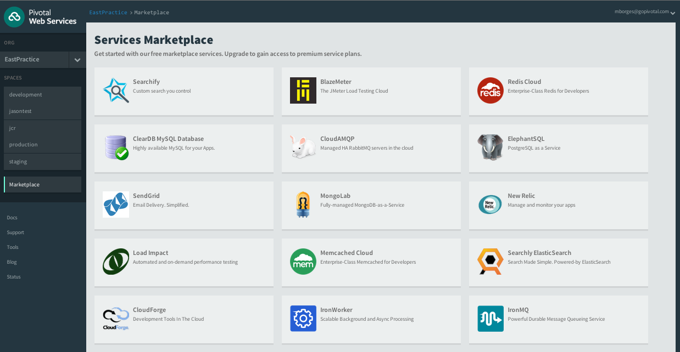
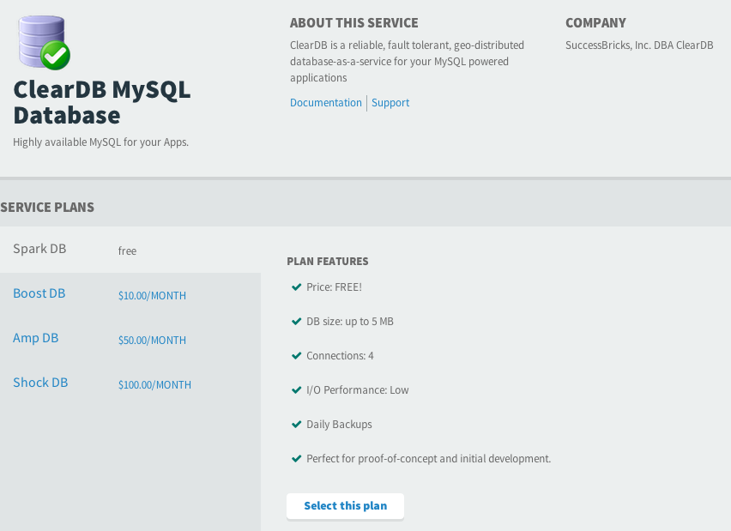
Demo: Services & Marketplace
Service is an external application dependency or components such as:
Database or Message Queue
Quickly access platform services via marketplace
Create services instances based on service plans
Bind Services to Applications
Notes:
https://docs.pivotal.io/pivotalcf/devguide/services/
TDB – Change the image to be consistent to the Ops Manager Image – maybe use the pivotal documentation
*** This is part of Apps Manager ***
The marketplace is a ERS concept. Typically Ops Manager Services tiles register their service brokers (keep it simple since services were not introduced yet) with the marketplace. The service broker publishes a catalog of service plans that can be consumed by applications deployed in ERS via Apps Manager.

Slide 25
PCF Demo
Application Health

